Slide 1


David Murphy
david.murphy.5@ucdconnect.ie
UCD Space Science Group

Slide 2
GIFTS & EIRSAT-1
GIFTS – PI: S McBreen
EIRSAT-1 – PI: L Hanlon

Slide 3
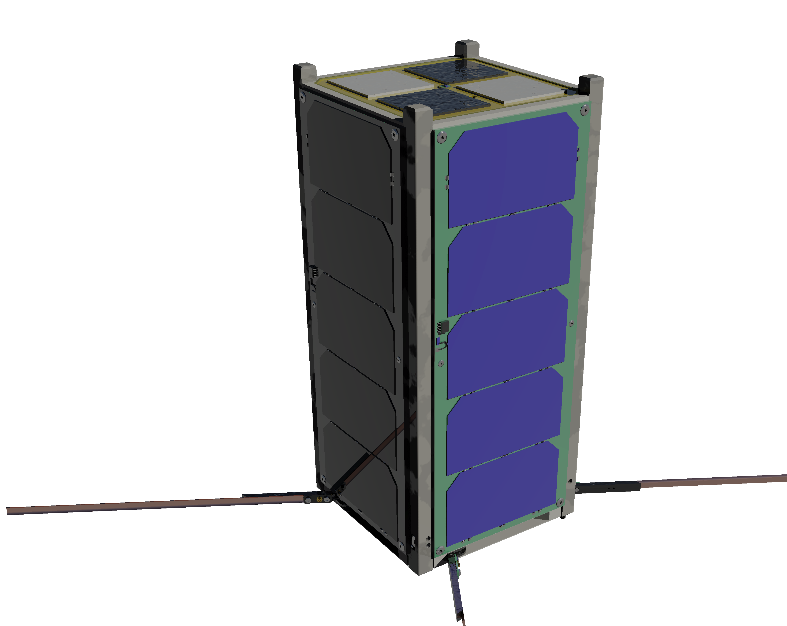
The EIRSAT-1 Mission
2U CubeSat selected by ESA Fly Your Satellite in 2017
3 experiment payloads, each incorporating novel Irish technology
  GMOD – a 𝛾-ray detector based on design developed at UCD under contract to ESA
  EMOD – to make LEO measurements of ENBIO’s SolarBlack and SolarWhite thermal management coatings developed for Solar Orbiter
  WBC – Wave Based Control, a control scheme for flexible mechanical systems, developed at UCD
Critical Design Review phase currently being closed out
Ambient Test Readiness Review has begun
EQM assembly beginning soon
The EIRSAT-1 project is carried out with the support of the Education Office of the European Space Agency, under the educational Fly your Satellite! Programme.

Slide 4
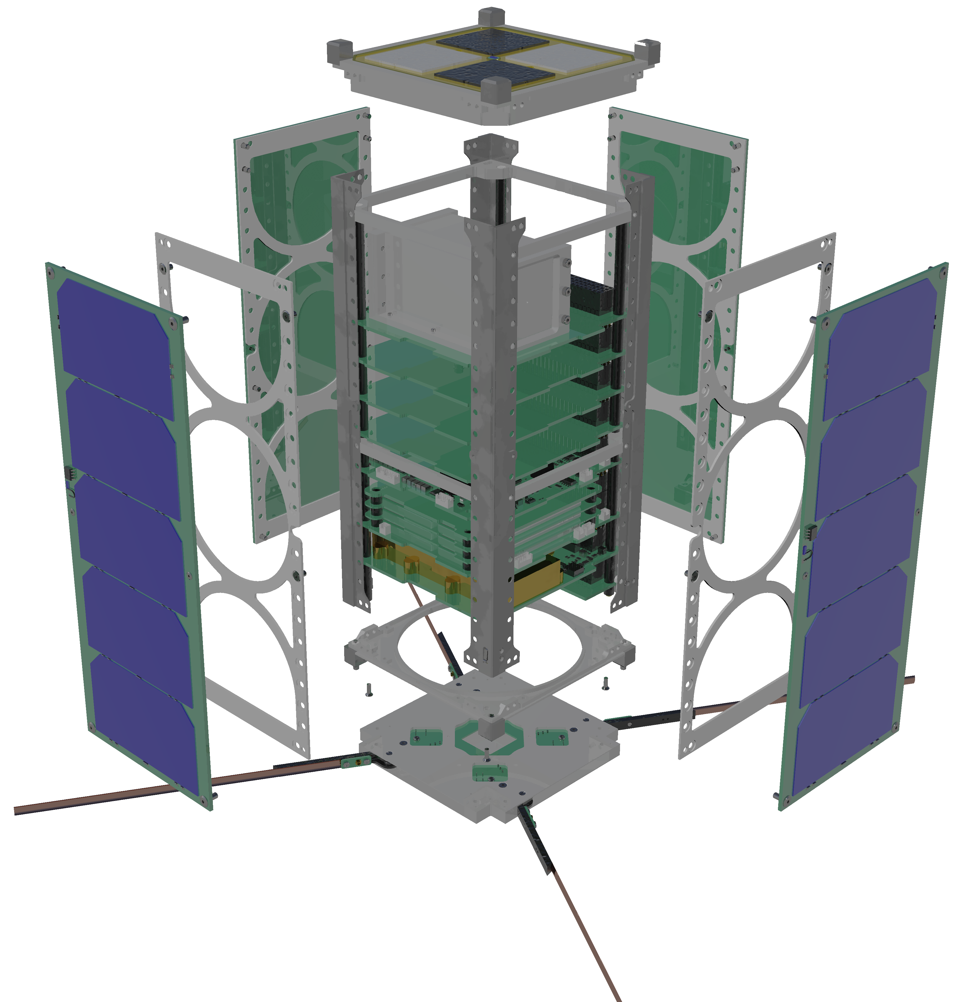
The EIRSAT-1 Mission
EMOD Thermal Coupon Assembly
Structural Frame
Solar Panels
GMOD
EMOD
Attitude Determination and Control
On-board Computer
EPS
Battery
Comms
Antenna

Slide 5
GMOD – The Gamma-ray Module
GMOD is a scintillator-based
gamma-ray detector
4×4 pixel SiPM array
  Based on SensL J-series
  Custom in-house array
Scionix Cerium Bromide Scintillator
SIPHRA ASIC by IDEAS
Custom in-house GMOD Motherboard
  Onboard Data-processing
  Support Electronics

Slide 6
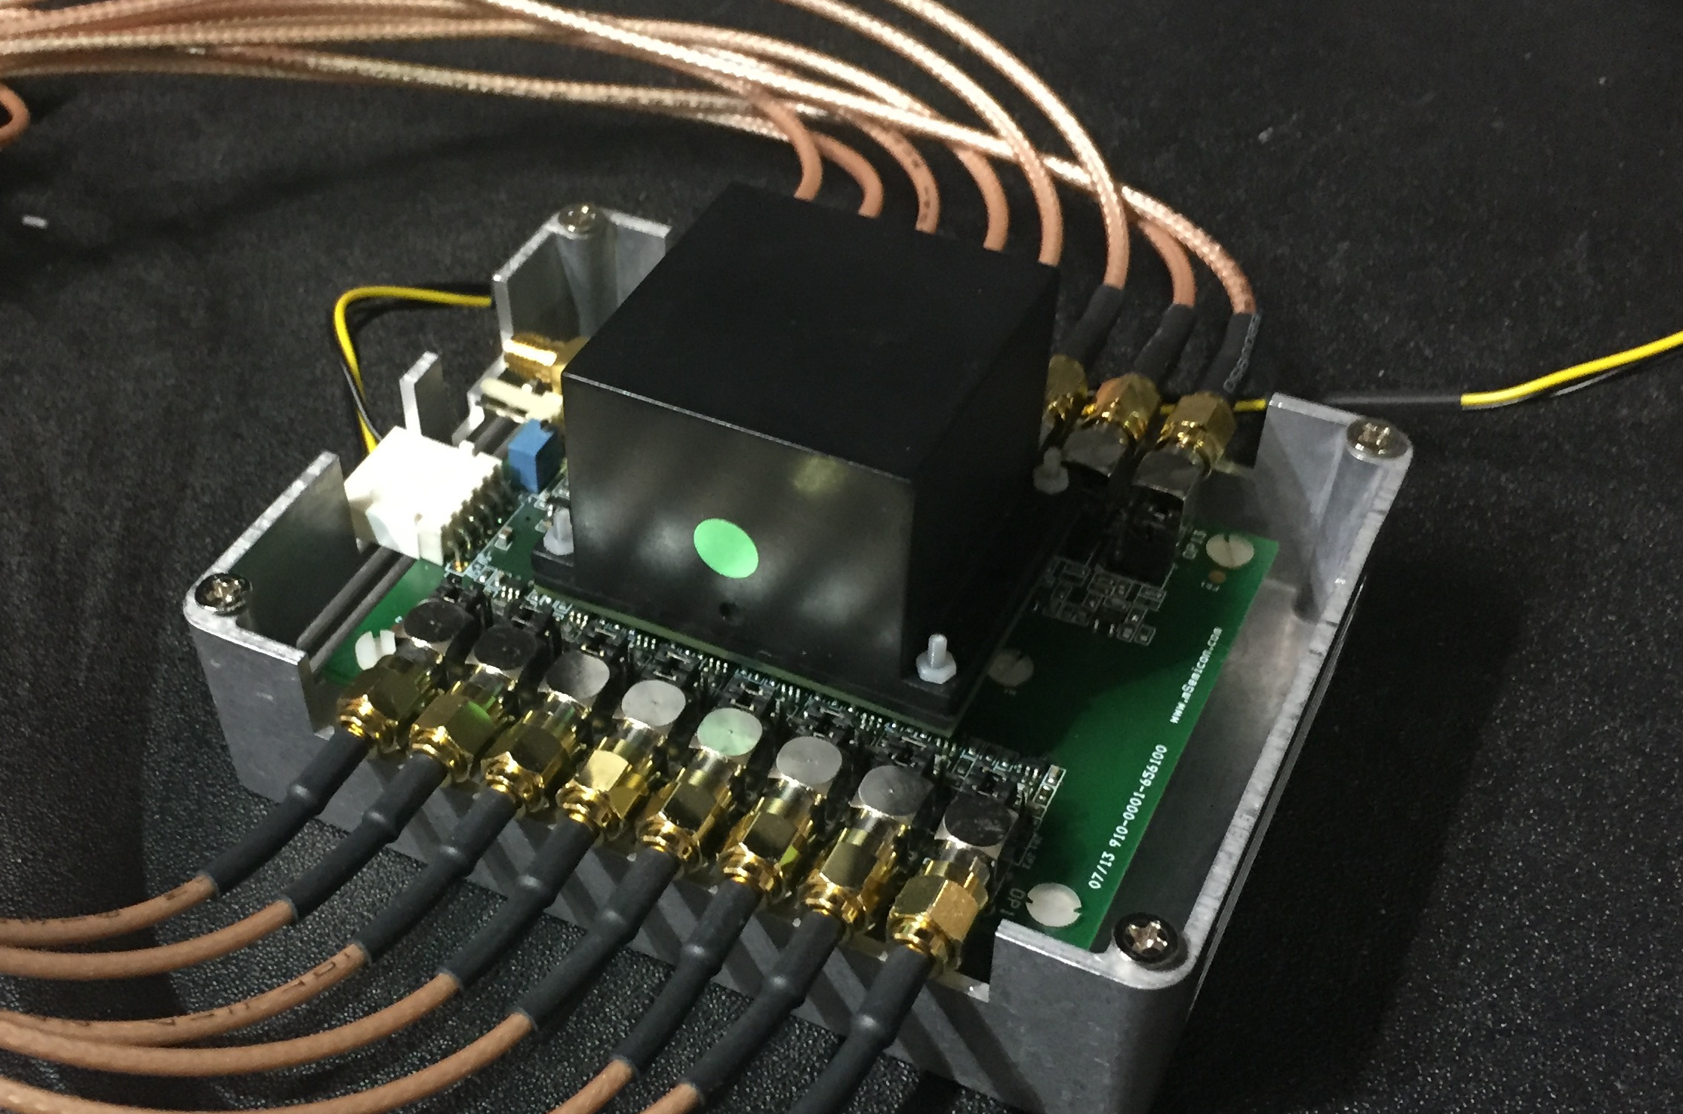
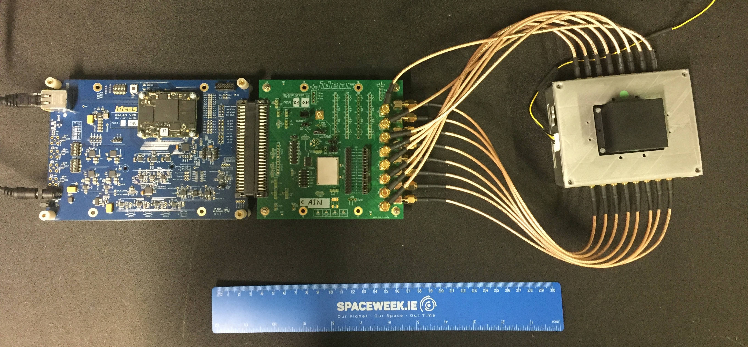
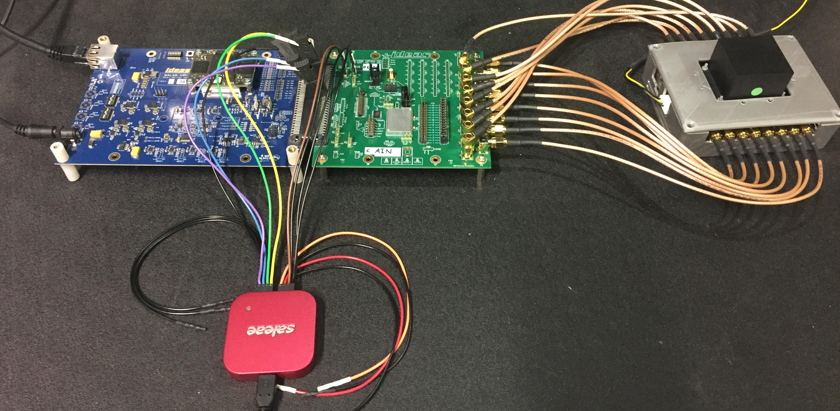
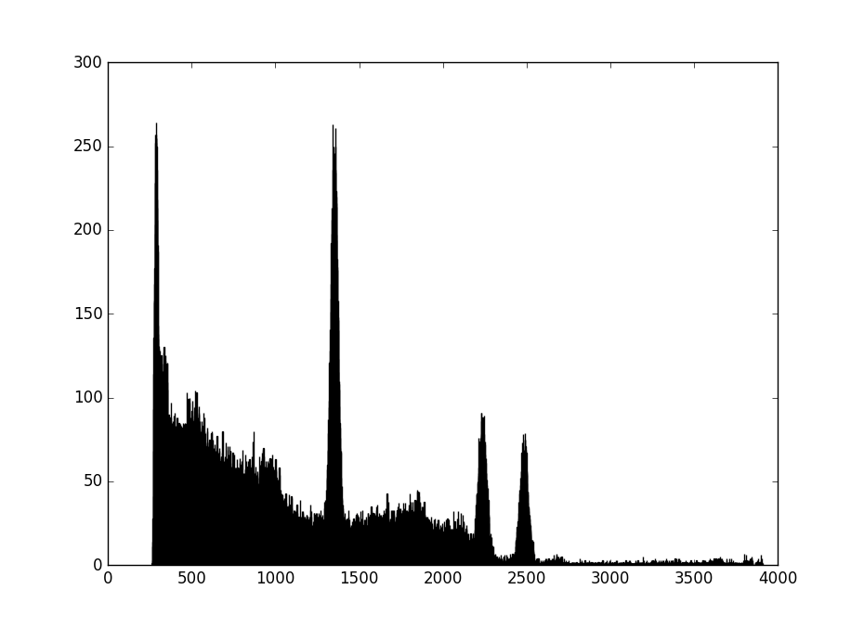
UCD GRD
IDEAS SIPHRA ASIC with Galao readout
Sample spectrum taken with SIPHRA and logic analyser
Cs137 – 662 keV
Counts
Co60 – 1.1 MeV
Co60 – 1.3 MeV
SIPHRA with readout via logic analyser
Channel

Slide 7
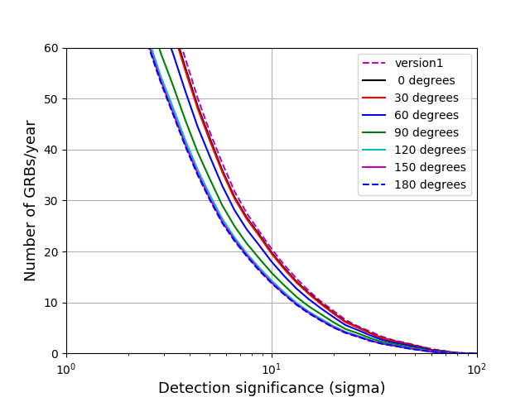
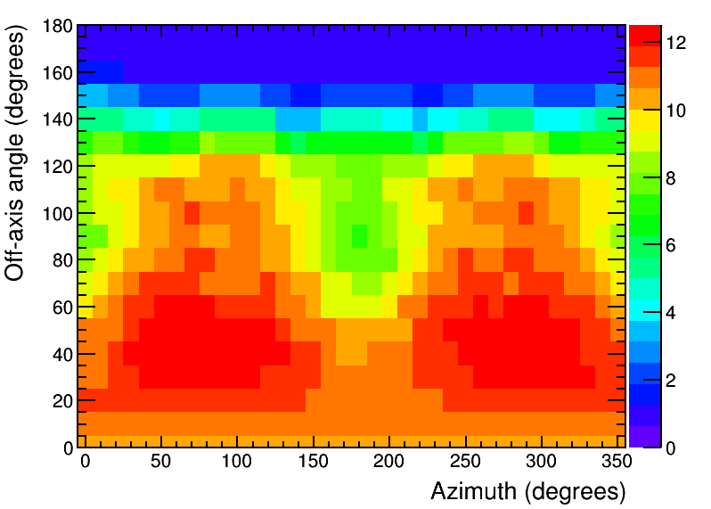
GMOD – Performance Simulations
Instrument Effective Area
GRB Detection Rate
Effective Area (cm²)
Monte Carlo simulation of 25mm × 25mm × 40mm CeBr3 crystal in EIRSAT-1 spacecraft
Simulations of BATSE 4B GRB catalog indicate detection of ~20 GRBs / year at a significance of 10 sigma
Effective area shown is a measure of sensitivity to 50keV to 300keV photons from a typical GRB
More GRBs can be identified at lower significance by coincidence with other instruments
Simulations: A Uliyanov

Slide 8

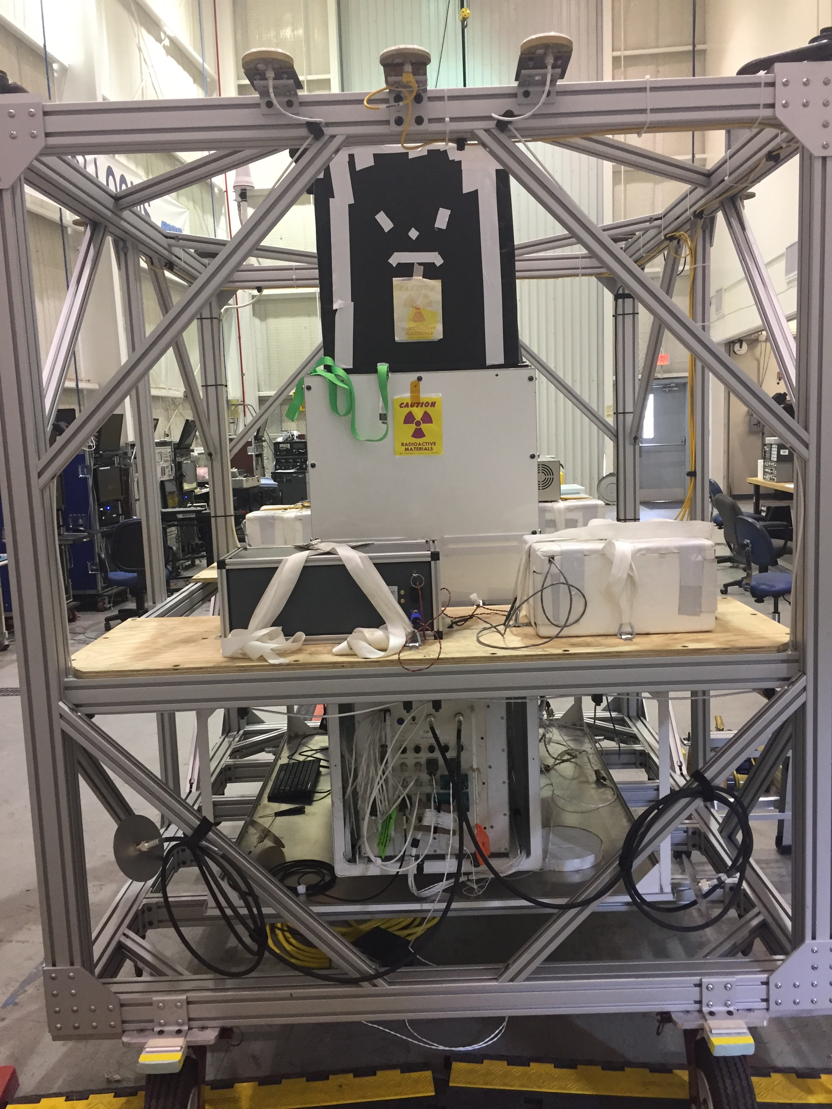
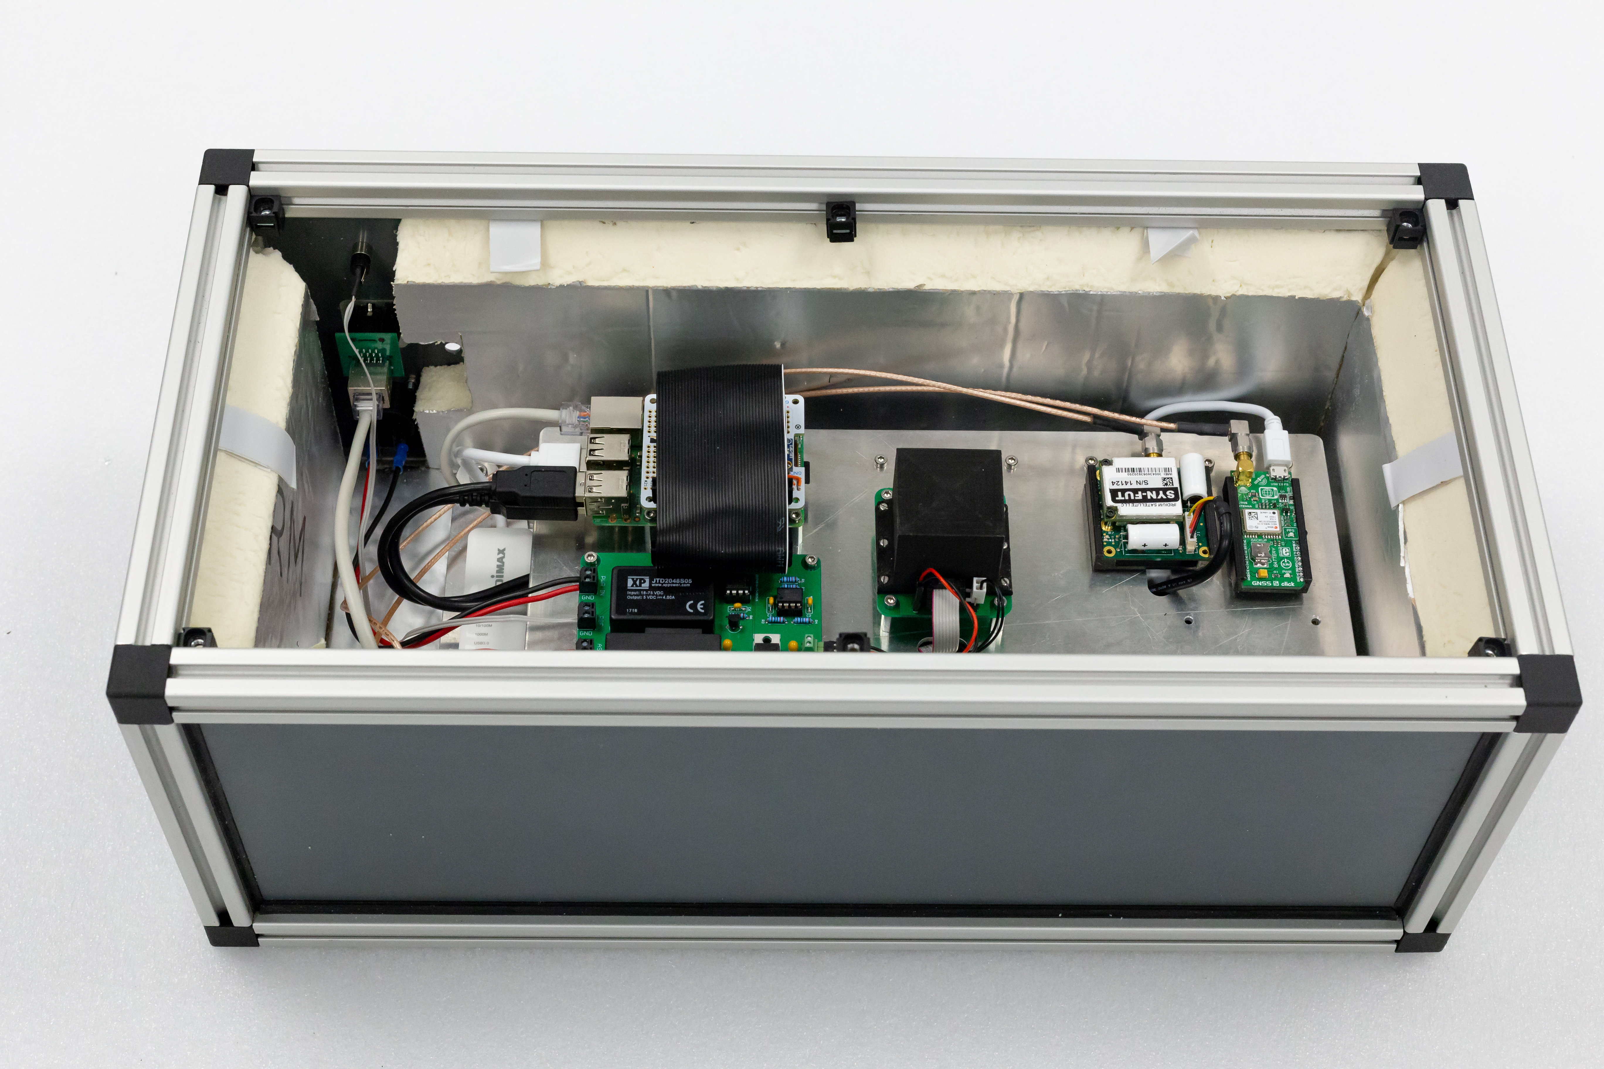
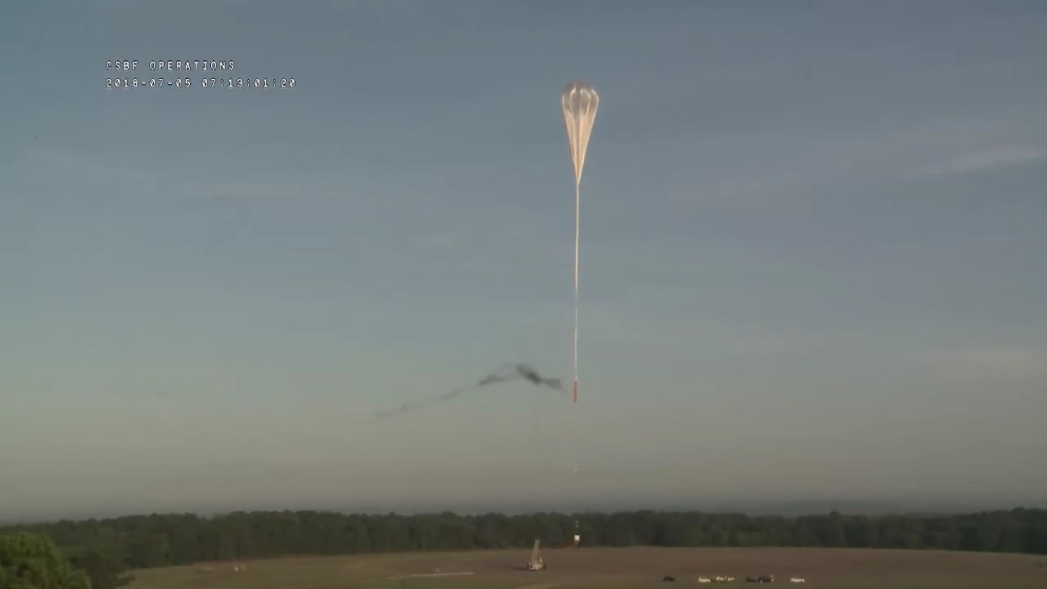
GIFTS – GMoDem:
The GMOD Demonstrator
Flew piggyback on the Advanced Scintillator Compton Telescope (ASCOT, PI: P Bloser) as Flight 1660P from the Columbia Scientific Balloon Facility in Palestine, Texas.
Float altitude 37.4km for >5 hours.
Hardware: SIPHRA ASIC, CeBr3 Scintillator, SensL J-Series SiPMs.
GMoDem
Detector Assembly

Slide 9
GIFTS – GMoDem
Counts
Energy (keV)
Results from flight still being analysed, but initial results are promising. The detector functioned well throughout the entire flight and after landing.
Analysis: J Mangan – MSc Thesis

Slide 10
GIFTS – Future
Funding has been secured to design and build a 1U sized instrument.
(with many thanks to BurstCube team for support!)
Would ideally form part of a 4U instrument collaboration in a 6U CubeSat.
Capabilities at UCD Space Science Group have been significantly increased in context of the EIRSAT-1 project.
  7 graduate students in group now working on spacecraft design and assembly – many more at UCD in Mechanical and Materials Engineering collaborating on EIRSAT-1 and potential future projects.
  2x new cleanroom facilities:
    one focusing on mechanical and vibration testing,
    one focused on gamma-ray instrumentation and final spacecraft integration.

Slide 11
Questions?
david.murphy.5@ucdconnect.ie sheila.mcbreen@ucd.ie lorraine.hanlon@ucd.ie

Slide 12
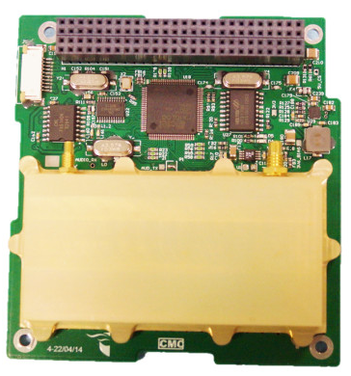
EIRSAT-1 Comms
ISS Orbit Communication Suitability
ISS Contact Time [Kiloseconds Per Year]
Latitude (degrees north)
CPUT VUTRX Transceiver
  UHF uplink
  VHF downlink
Data rates up to 9600 baud with GMSK
Ground Station will be constructed at UCD School of Physics
Nominal ~29 minutes of contact with EIRSAT-1
per day
Performance considerably better than ground stations in equatorial regions

